Slide 1

What Is
By Dominick Prevedel

Slide 2


.NET is a free, popular, open source software to develop many types of applications

Slide 3


Made By Microsoft
Made In The Late 1990s
Specifically by Anders Hejlsberg, Jean Paoli, and Don Box

Slide 4



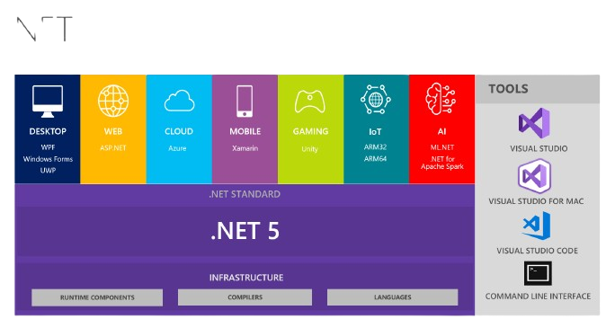
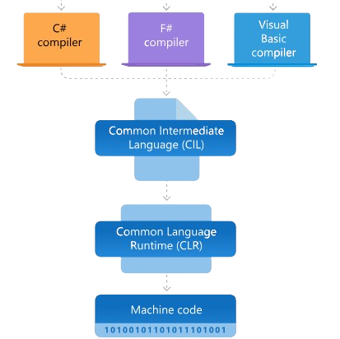
What .NET Offers

Slide 5

How .Net Helps Businesses
Makes development more efficient with
Offering many application models
Providing base libraries

Slide 6
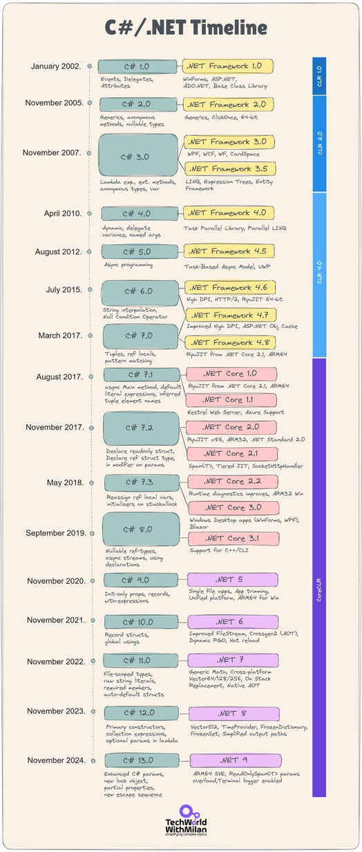
Important .NET Notes
.NET Framework
.NET
Newer
Older
Implements .NET Framework
Not Cross Platform

Slide 7


.NET
What Is .NET?
A free, popular, open source software framework to develop many types of applications
Made in the late 1990s under Microsoft. Specifically by Anders Hejlsberg, Jean Paoli, and Don Box
.NET helps businesses by making development more efficient with
Offering many application models
2. Providing base libraries
Types Of .NET
.NET
.NET Framework
Newer
Older
Implements .Net Framework
Not Cross Platform

